Slide 1
Flexitive
Summary

Slide 2
Schneider H5 Banner
Good: Different size and ratio’s image can be changed rapidly.
Bad: When changing the image also changed the other templates image. I suppose they use the same image. They suggested we can use the text component.

Slide 3
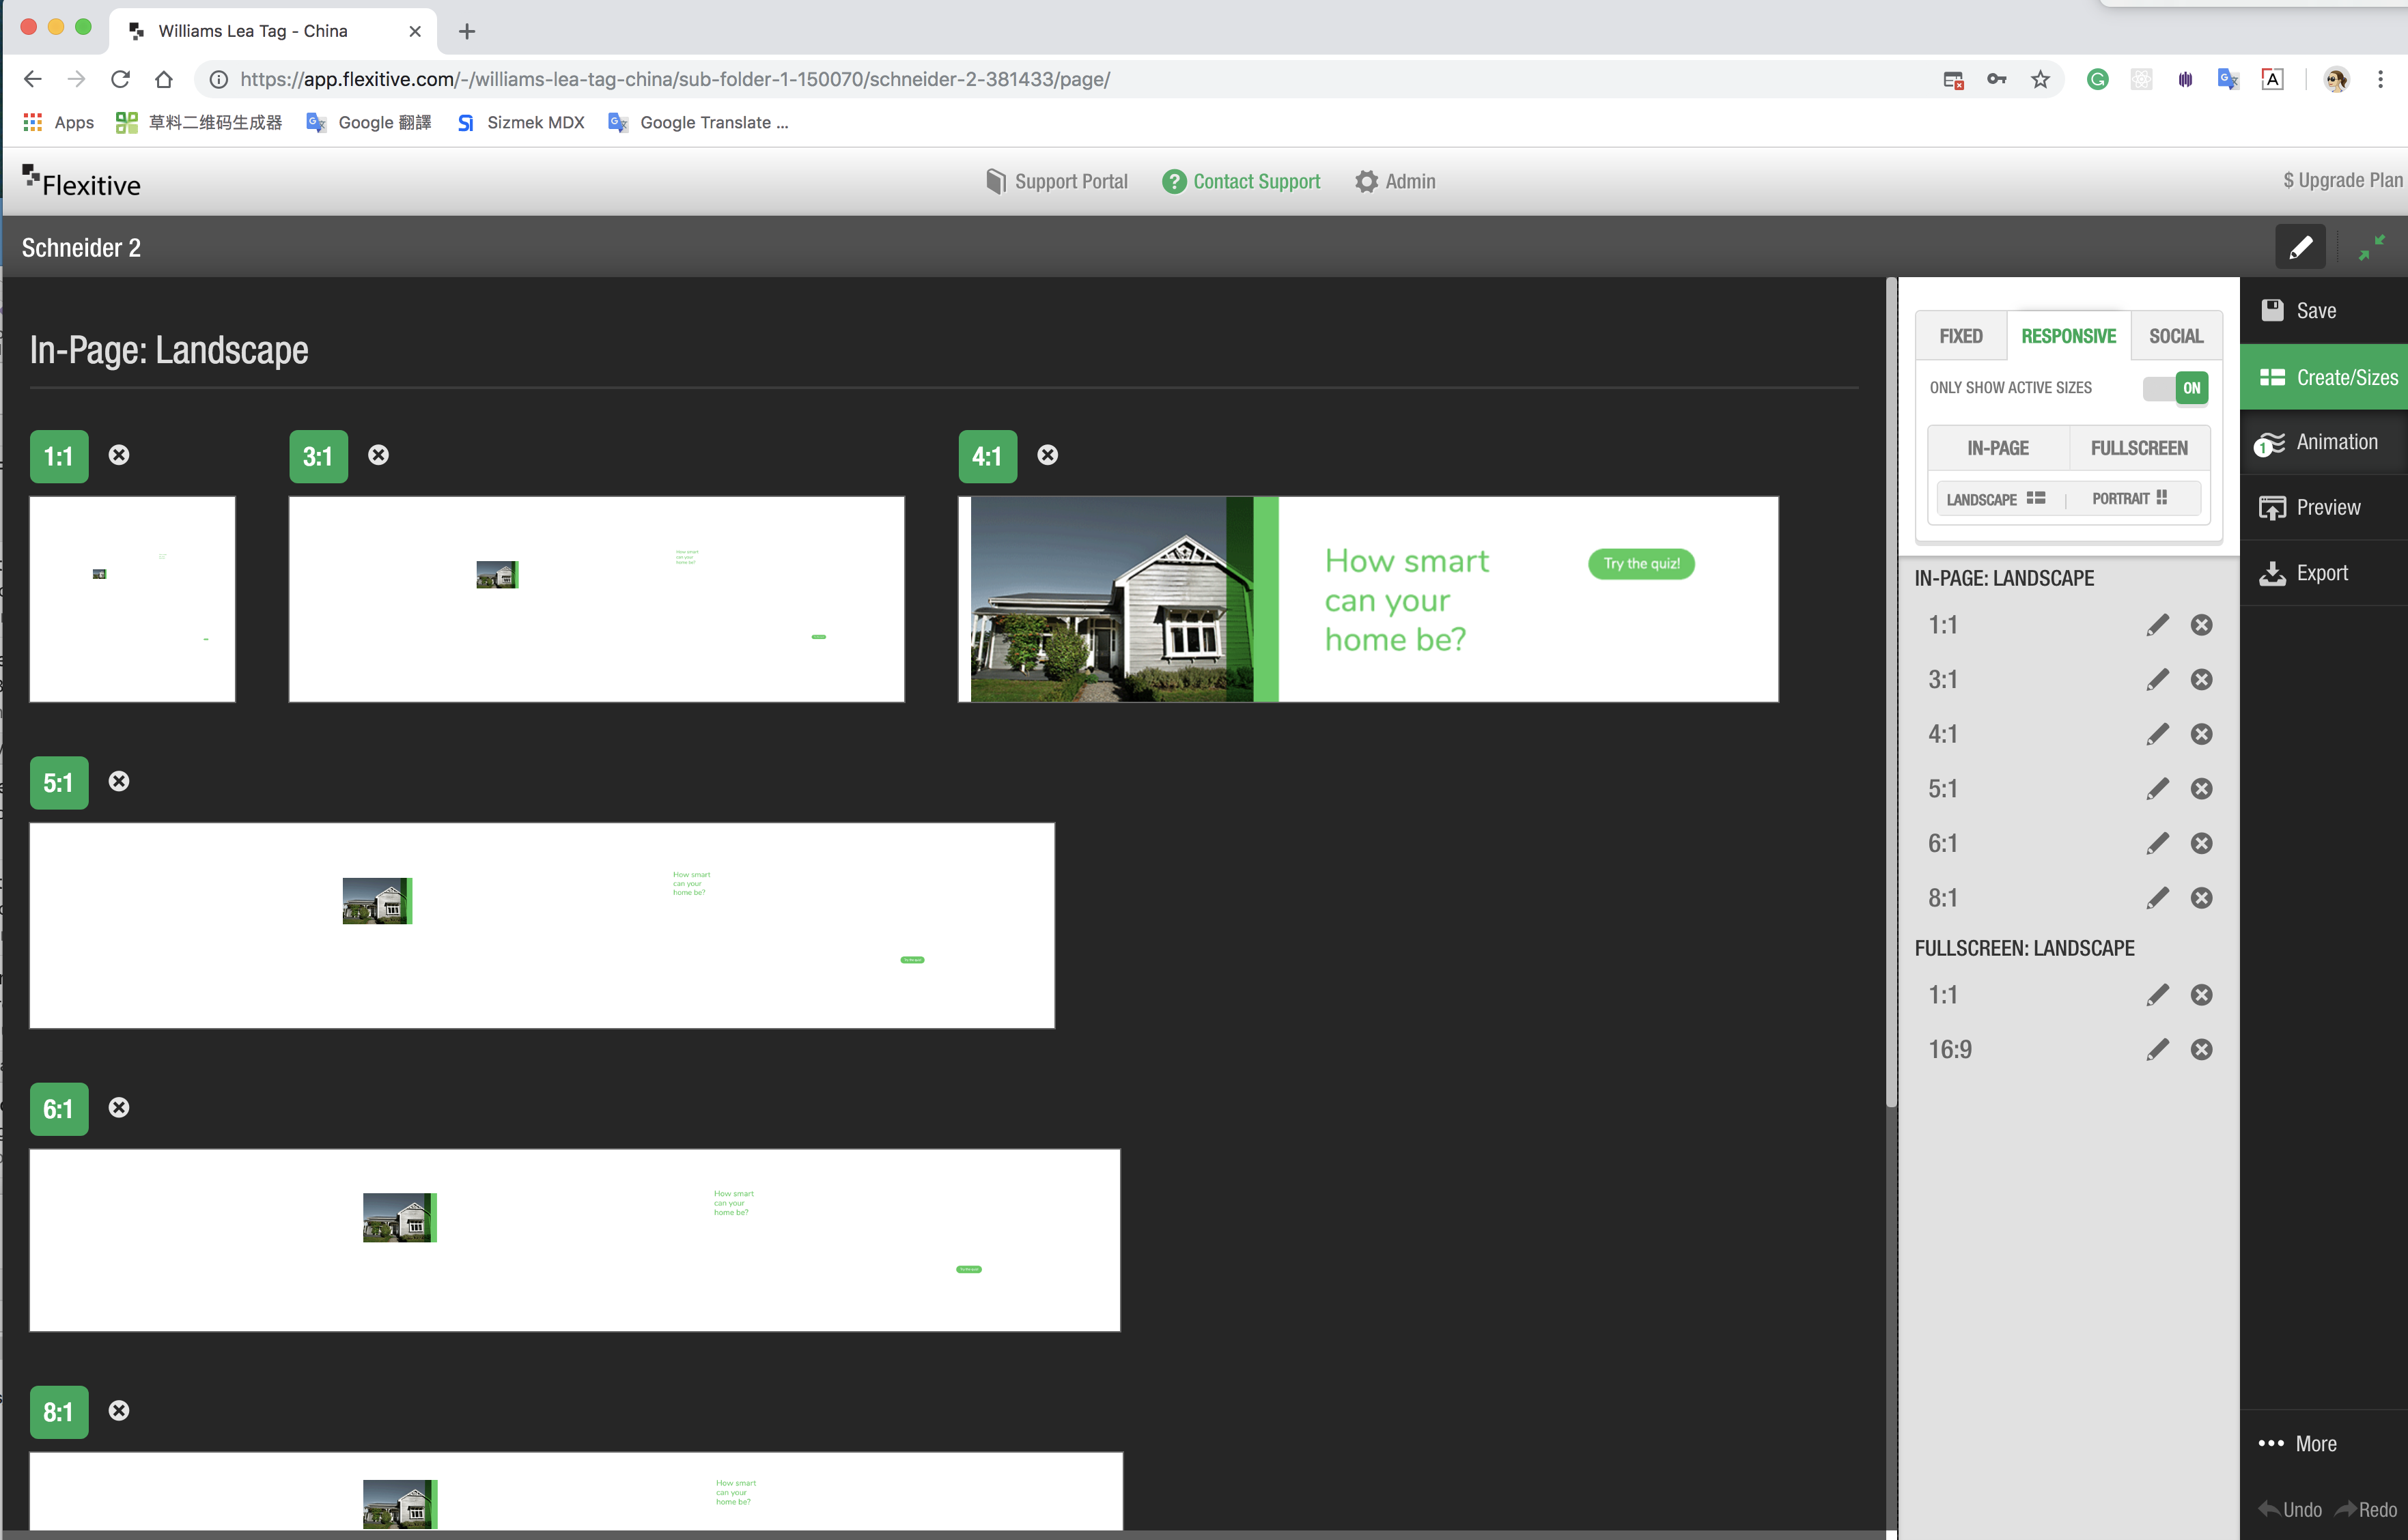

Slide 4
Precision control
Good: Upload the font is convenience.

Slide 5
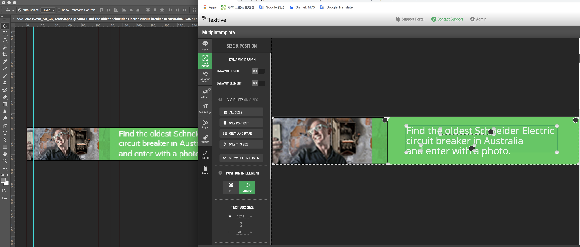

Slide 6
Rulers & Extras
Bad: Edit banners’ position precision still need to improve. It hasn’t ‘Extras’ like Adobe. The ‘Rulers’ don’t flexible enough.

Slide 7
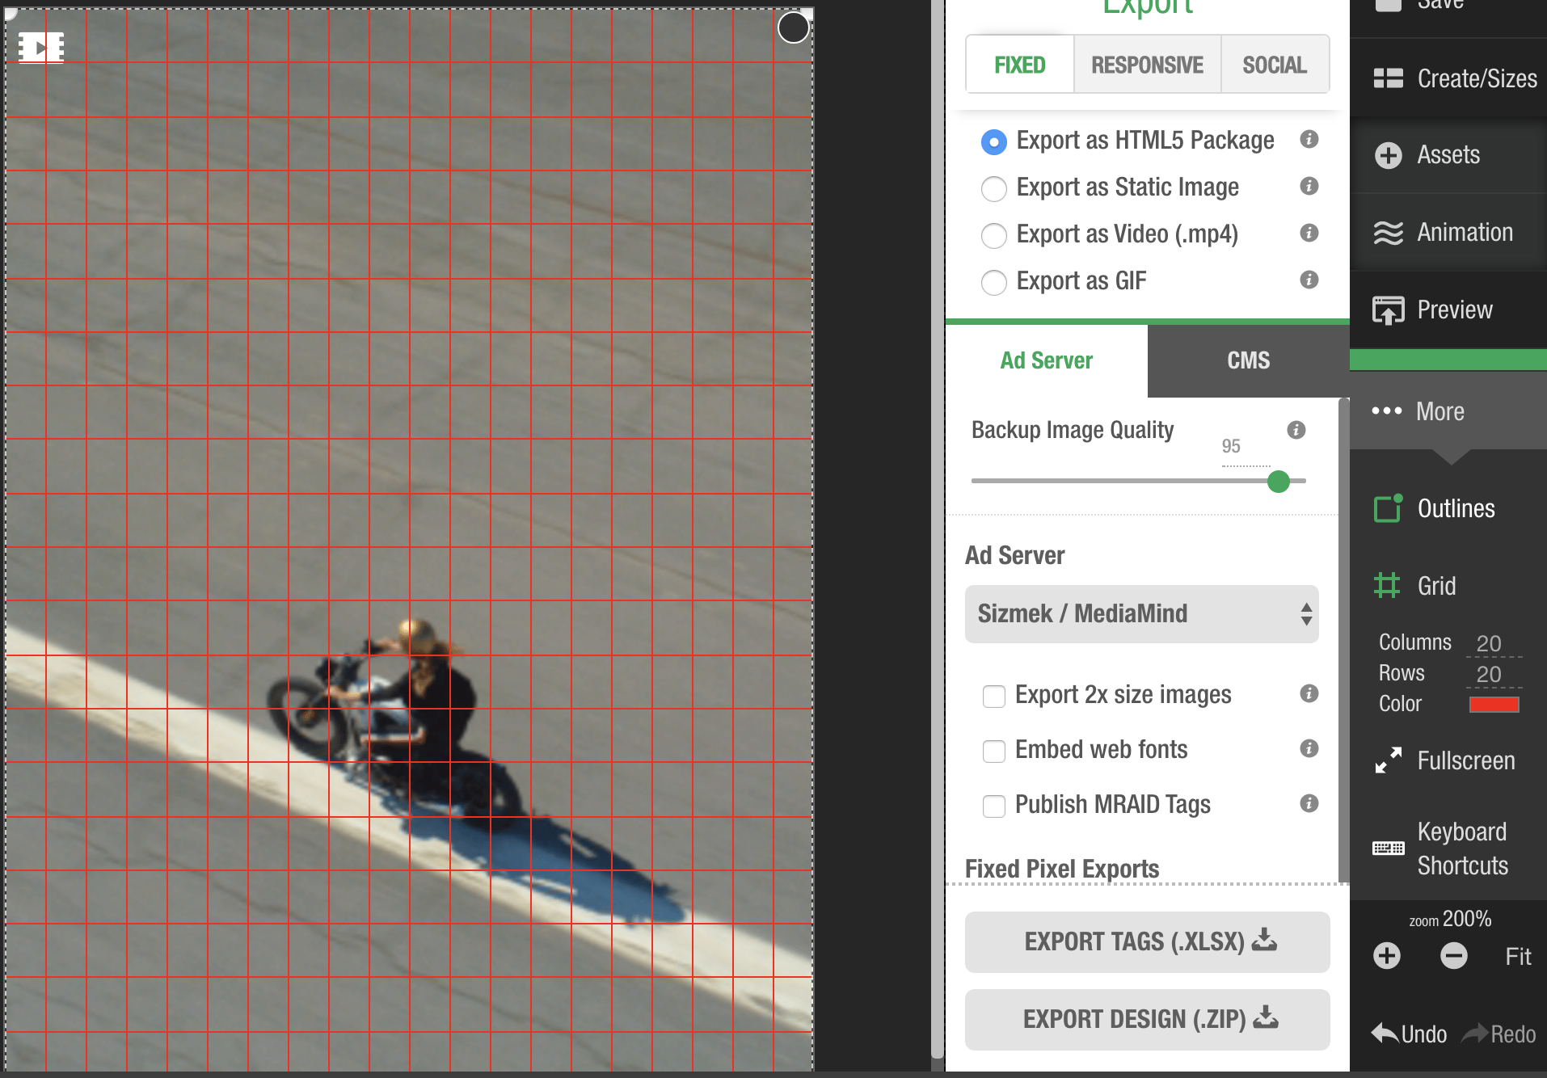

Slide 8
Preview
Good: Preview page can review multiple animation banners a meanwhile.

Slide 9
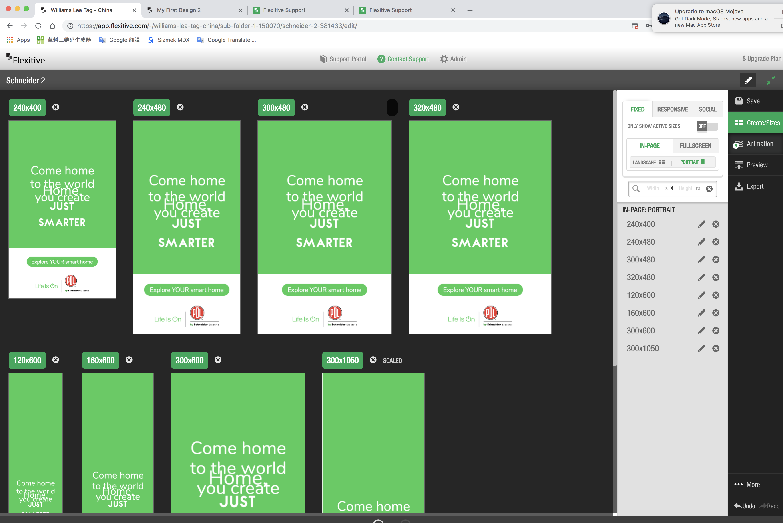

Slide 10
Download & Package
Good: A lot of banners can be download and share at the same time.
Good: Support multiple platforms, such as Sizmek and DCM.

Slide 11
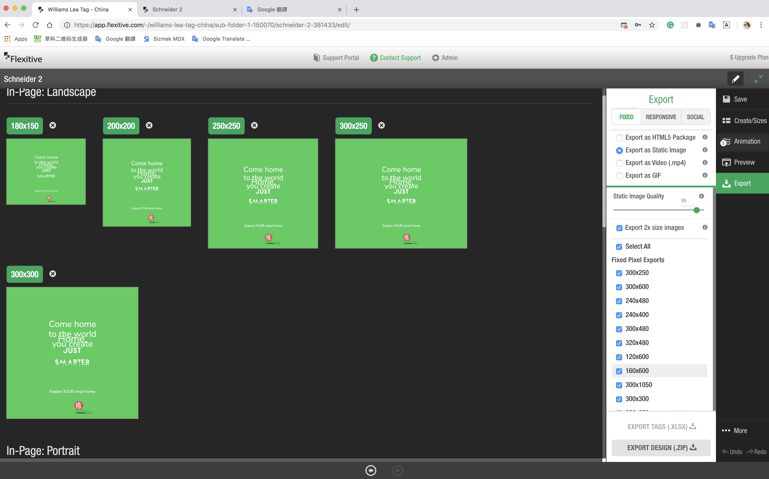

Slide 12
Compression
Good: Code and compress are good.
Bad: Some image is too compressed and blurred.

Slide 13
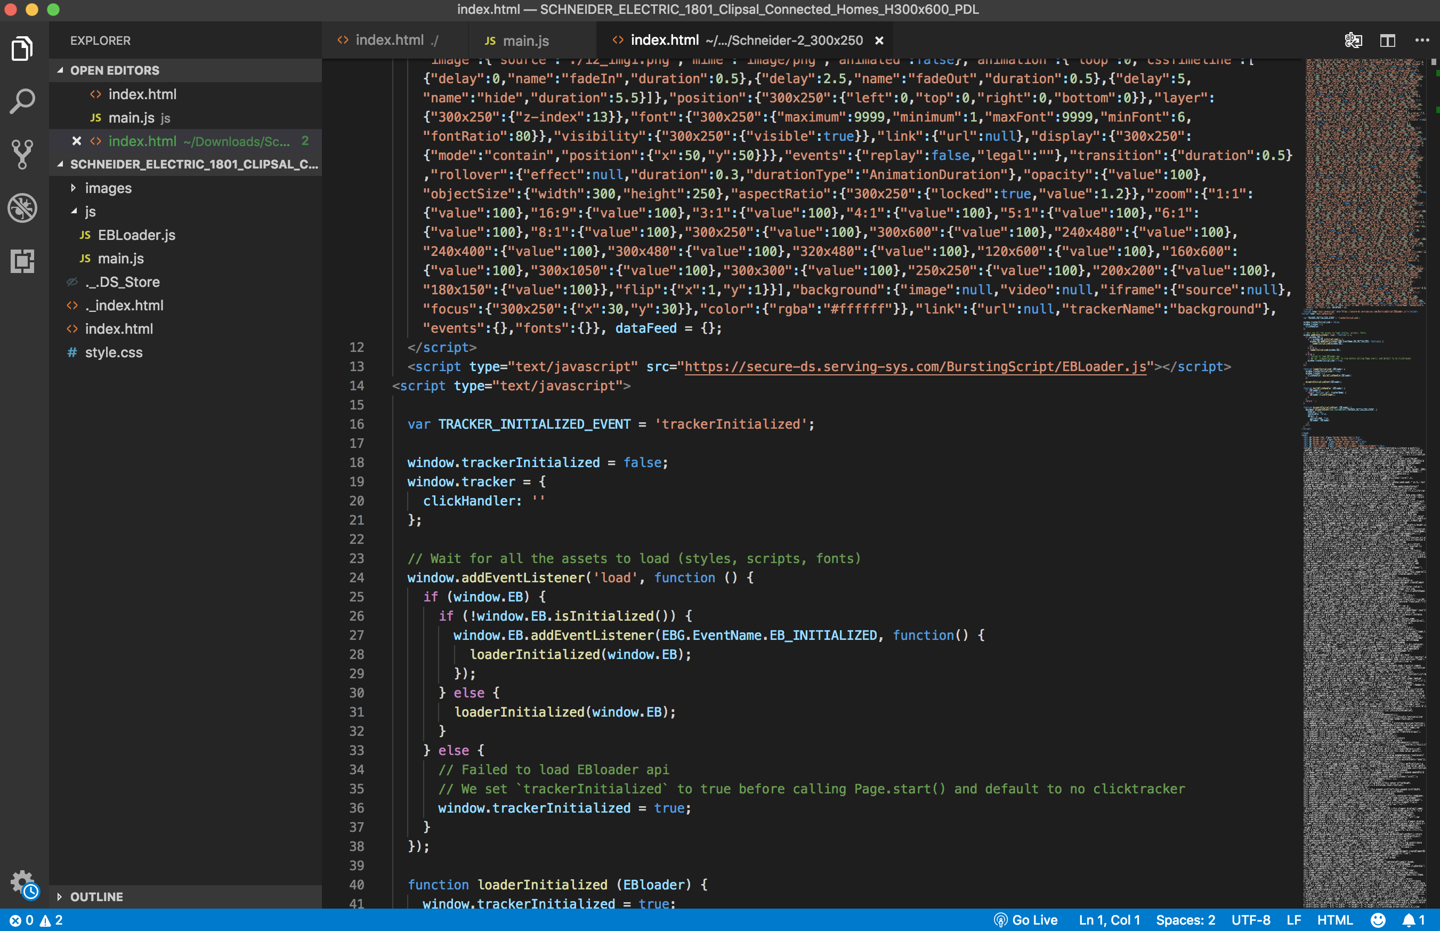
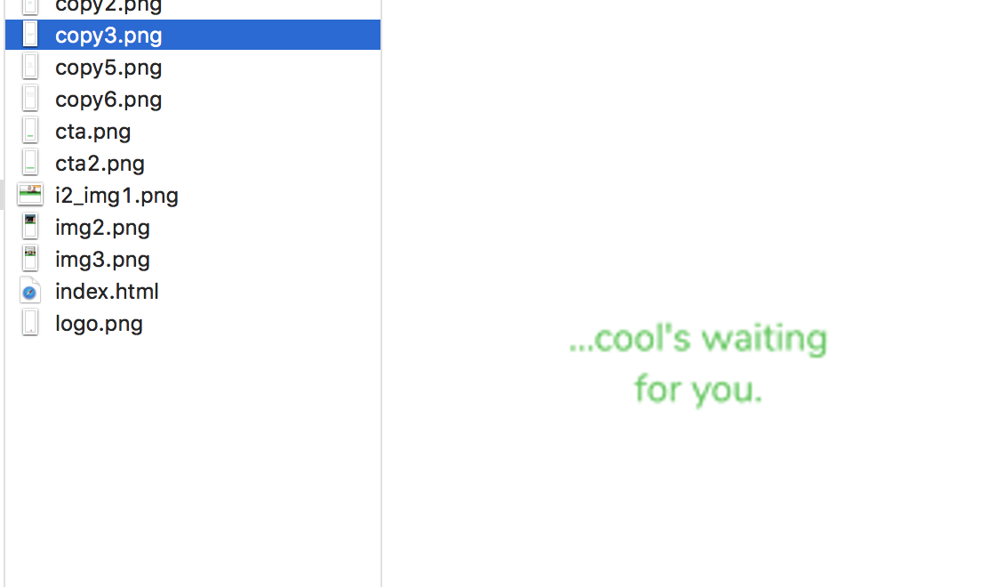
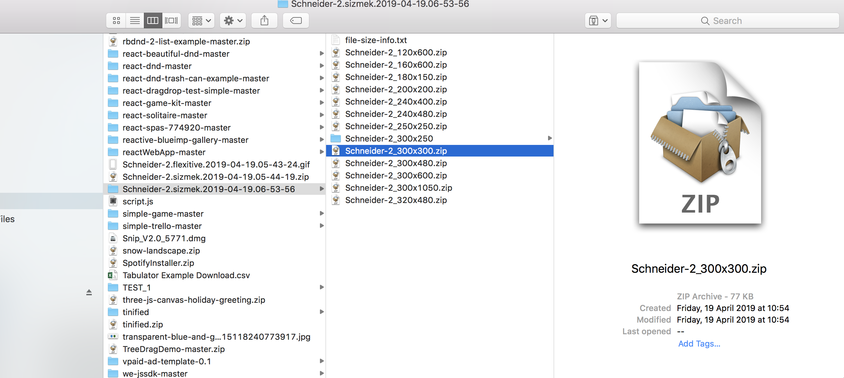

Slide 14
JS & Canvas animation
Bad: Don’t support the JS code and canvas animation.

Slide 15
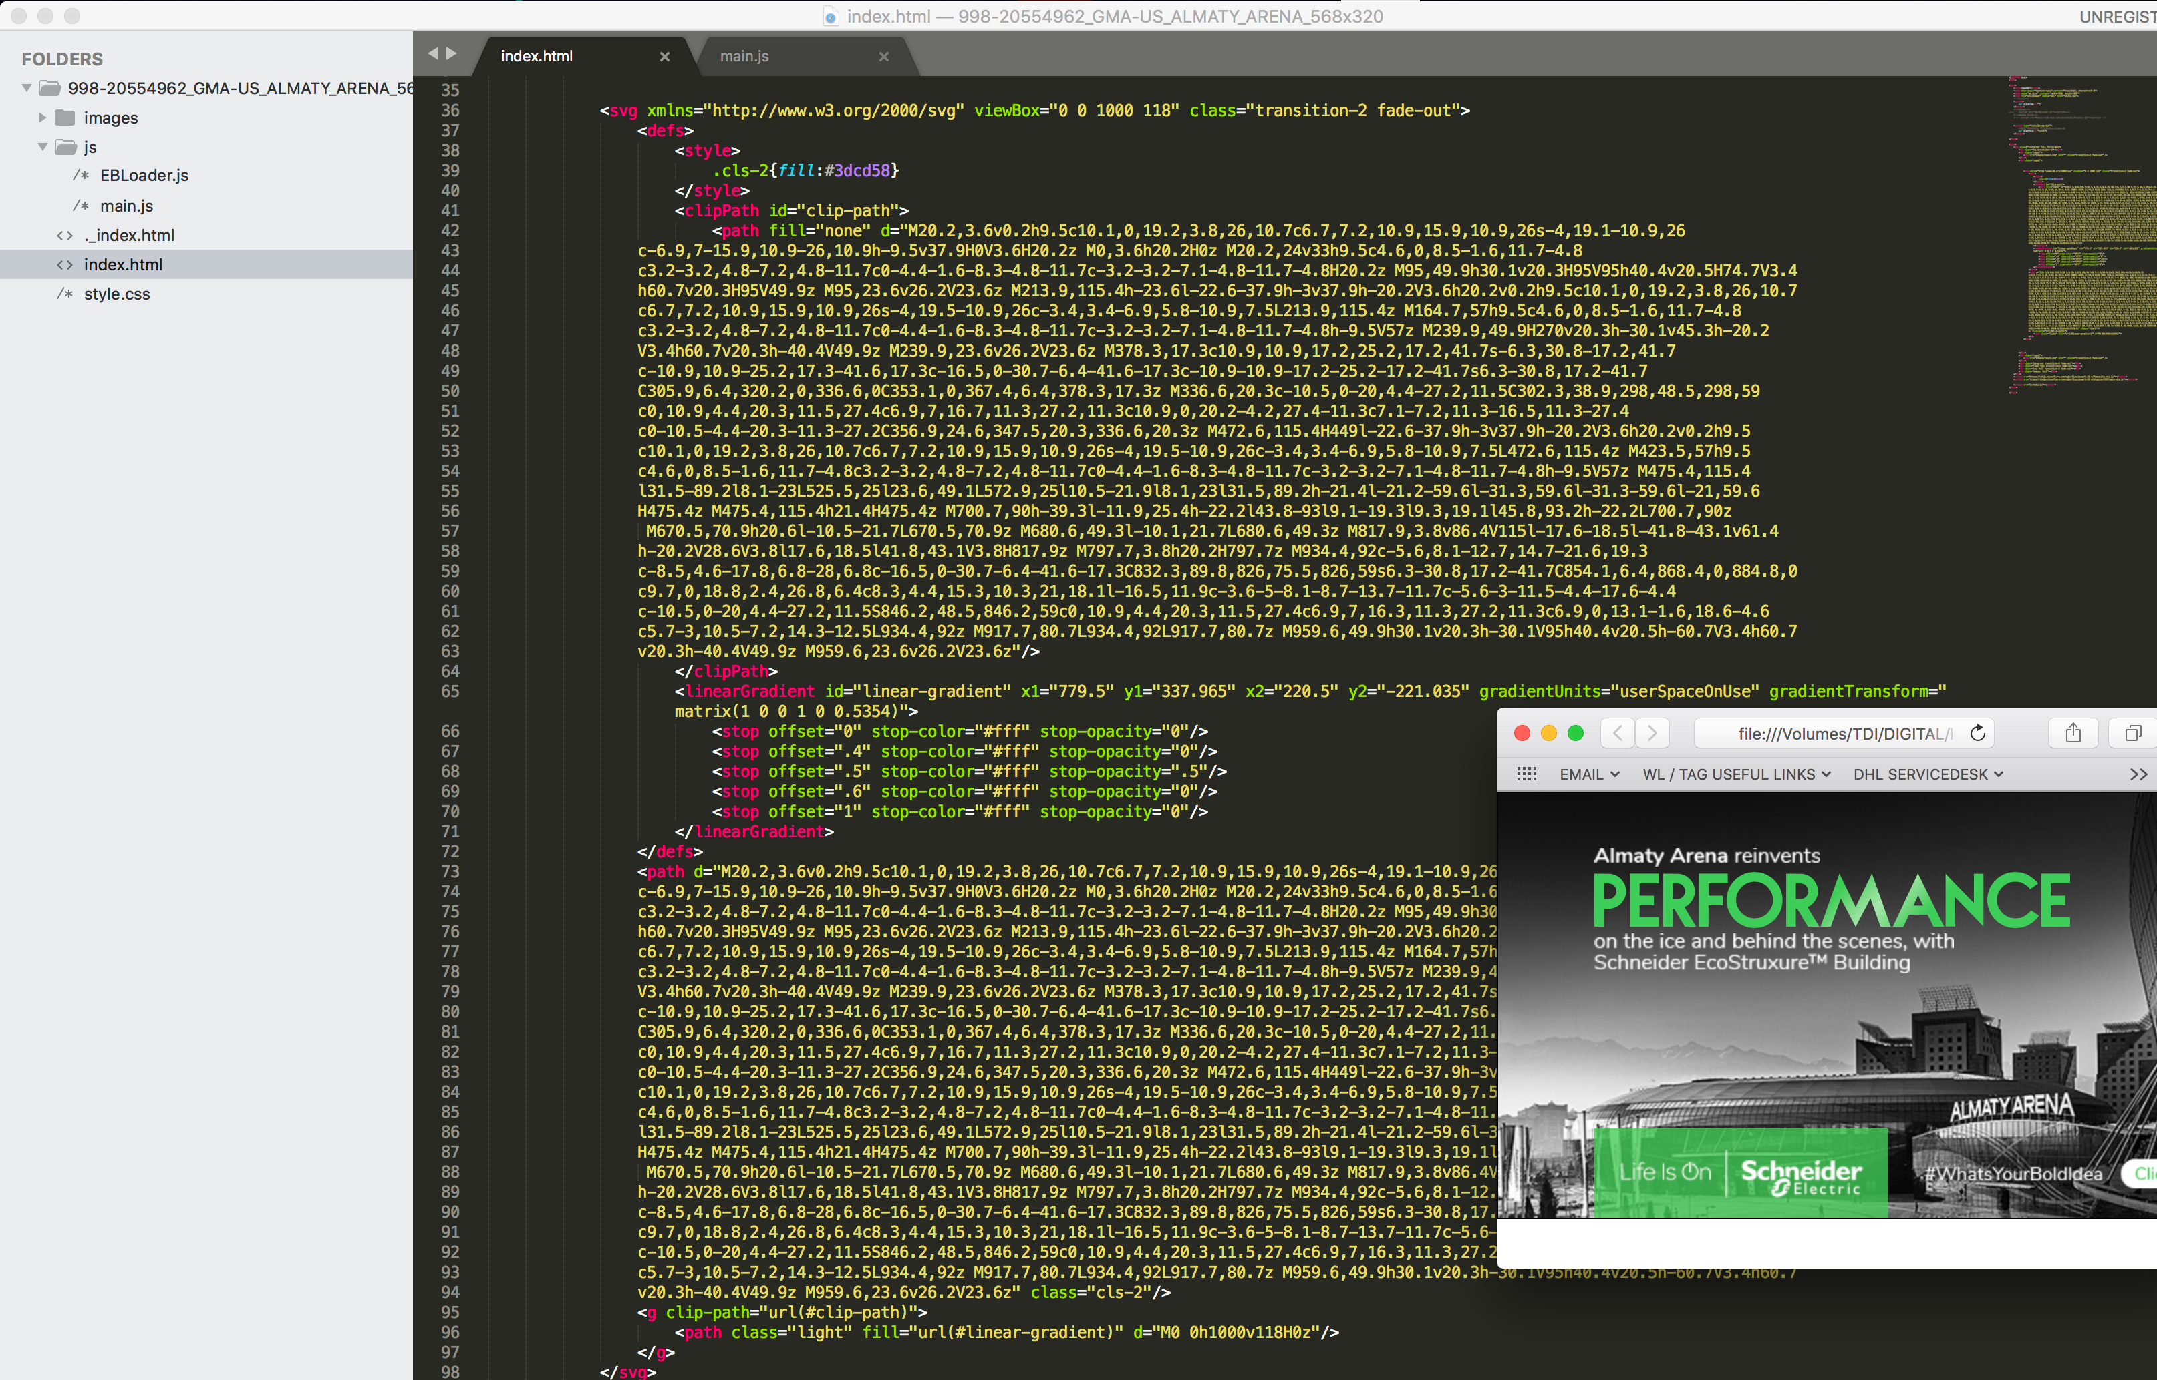

Slide 16
Cartier
Bad: Couldn’t add the play & mute button for video.

Slide 17
